Slide 1

INTERNSHIP REPORT
Name: Dasara Sai Ram
Register Number: 192210258

Slide 2
TABLE OF CONTENTS
Introduction
Company Overview
Internship Objectives
Work Responsibilities
Challenges and Solutions
Skills Gained and Knowledge Acquired
Contribution to the Organization
Conclusion

Slide 3
INTRODUCTION
About me.
Purpose of the internship
Duration and location
I Dasara Sai Ram, a student of B.Tech in the Department of Computer Science and Engineering solemnly affirm that the internship experience documented in this report reflects my direct involvement in a formal organizational setting, actively engaged in industry-relevant operations.
To entrust with tasks and responsibilities that were integral to the company’s ongoing functions. The insights and observations included herein are a true representation of the work culture, technical exposure, and professional interactions I encountered at Codec Technologies.
Duration: MAY,01,2025 – AUGUST,31,2025
.

Slide 4
COMPANY OVERVIEW
About the Organization.
Name of the Company: Codec Technologies
Nature of Business/Industry Sector: Online Education & Technology Training
Brief History & Overview: Codec Technologies is an Technology Services,
online education and internship platform that training opportunities for students in various technical provides practical mains such as java Development, Data Science, Artificial Intelligence, and Software Development.
Location(s): Hyderabad , India.
Services Offered: java Development, Software Solutions, IT Services.
The department I worked in.
Internship Title/Designation: Java Development Intern
Department/Division Assigned: Java Projects Division

Slide 5
INTERNSHIP OBJECTIVES
Primary objectives of internship.
Hoped to achieve during the internship.
Gain practical exposure to Java development workflows
Contribute to backend application modules and understand practices and team collaboration.
Participated in Java development tasks and assisted in building backend logic
Worked with core Java, JDBC, JSP, SQL to design and develop simple web applications.
Practiced debugging, clean coding, and documentation to align with industry standards.

Slide 6
WORK RESPONSIBILITIES
Projects I worked on or assisted with
My main tasks and responsibilities.
Student Management System: Developed modules for login, student registration, and course allocation using Core Java and JDBC.
Library Management Application: Built backend logic with Servlets and JSP to manage book records and user transactions.
RESTful API Integration: Created APIs with Spring Boot to handle data exchange between frontend and backend systems
Designed and implemented backend modules using Core Java, JDBC, Servlets, JSP, and SQL.
Connected applications to relational databases and performed CRUD operations.
Tested and debugged Java code to ensure proper functionality and performance.
Collaborated with team members, shared project work through GitHub, and participated in code reviews.

Slide 7
CHALLENGES AND SOLUTIONS
Challenges I faced during my internship.
Learning new Java development concepts.
Fixing coding errors.
Managing time to finish tasks.
How I addressed or overcame them.
Practiced coding and improved understanding of Java development.
Debugged errors and tested the code carefully.
Planned tasks properly to complete work on time.

Slide 8
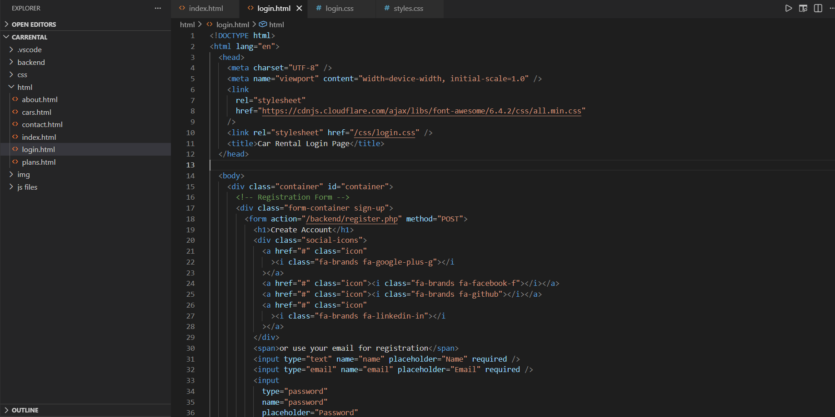
SKILLS GAINED AND KNOWLEDGE ACQUIRED
Tools, software, or methodologies I learned.
The professional and personal skills I developed.
Pictures if any..
Programming Languages: Core Java, SQL
Tools: VS Code, GitHub ,Eclipse IDE,
SQL Workbench
Technologies: JSP, Spring Boot, JDBC, Servlets
Improved backend development and coding skills.
Learned problem-solving and debugging and clean coding practices.
Improved teamwork and communication skills.

Slide 9
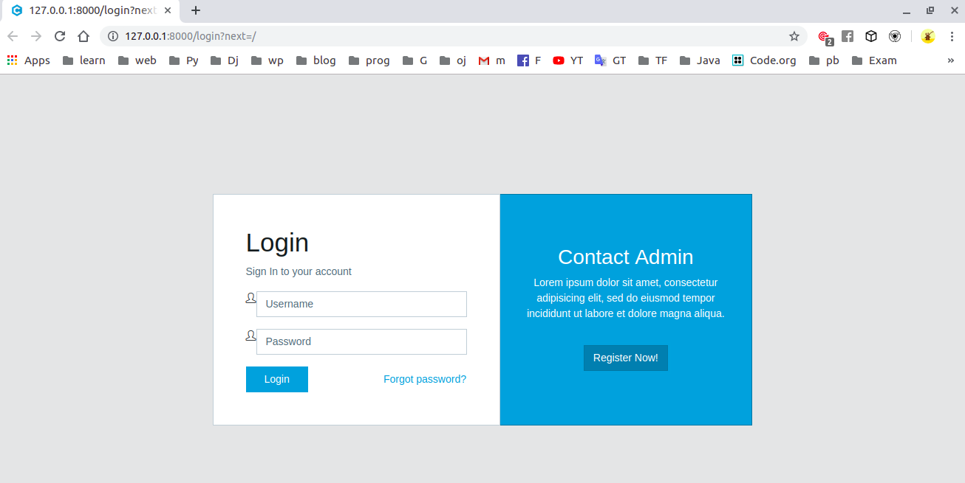
Project Work

Slide 10
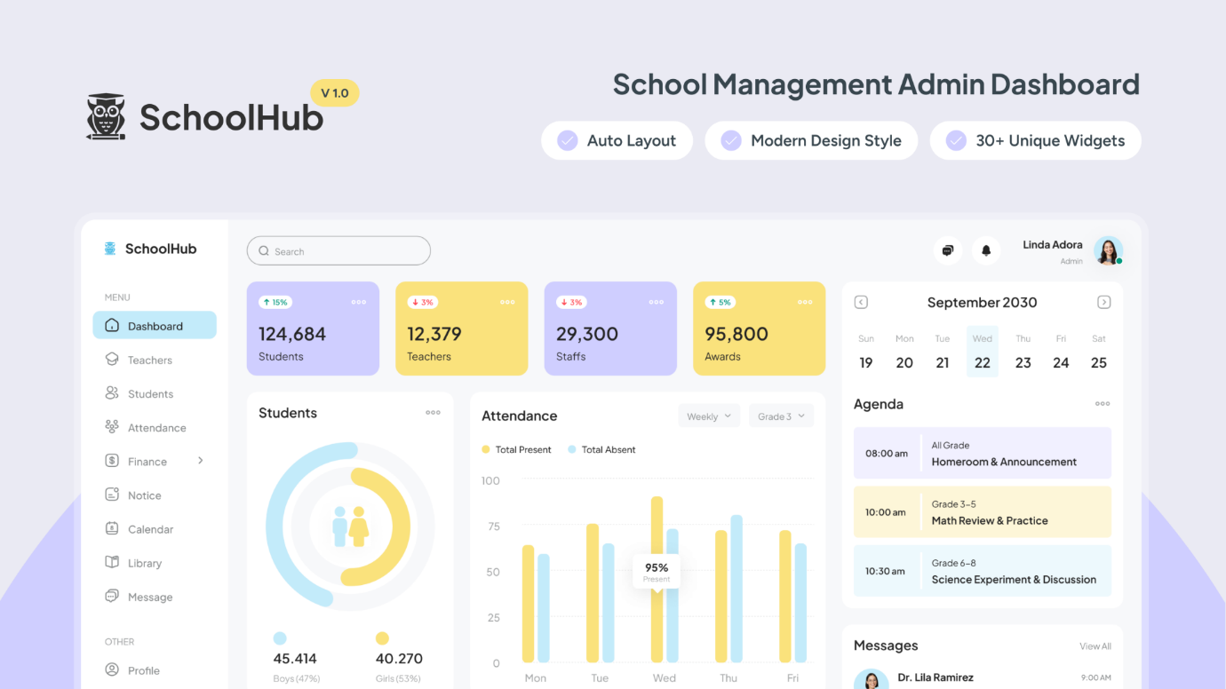
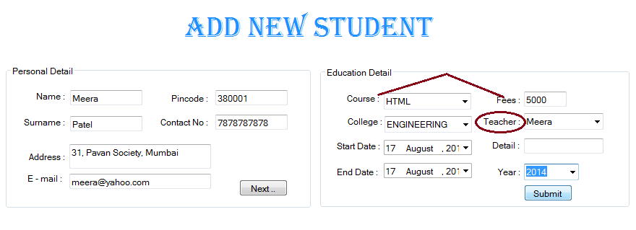
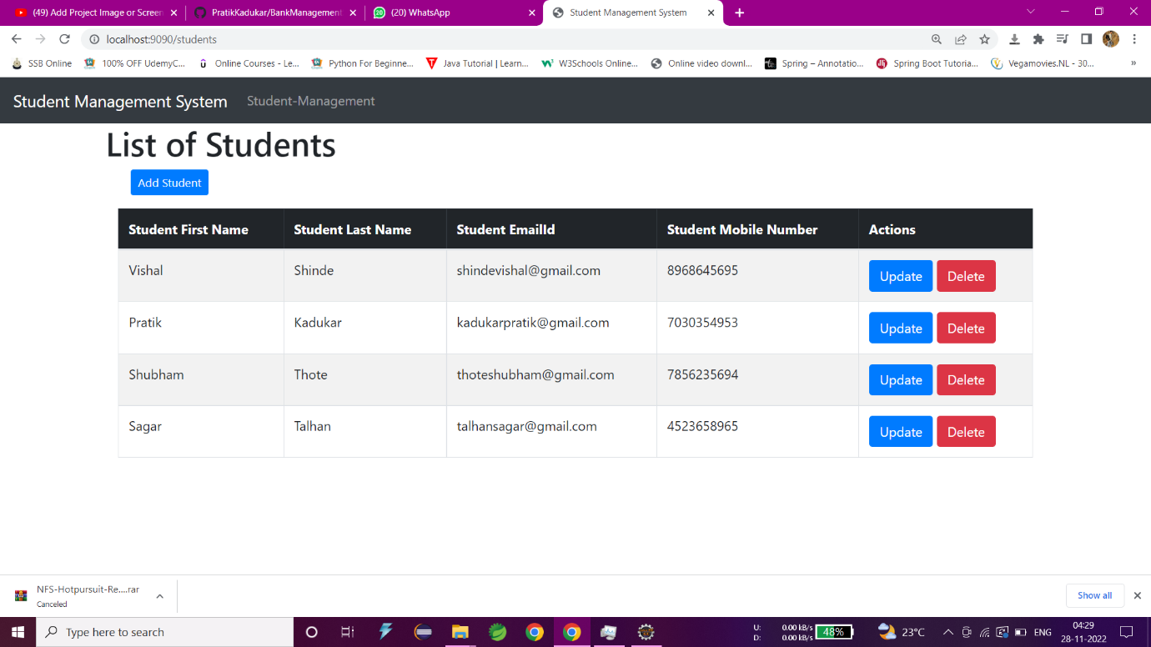
Project Work

Slide 11
CONTRIBUTION TO THE ORGANIZATION
How my work added value to the organization.
Feedback received from my supervisor or team.
Helped in developing backend modules for applications for using Core Java, JDBC, JSP.
Created reusable code that supported faster development.
Actively participated in team discussions and project improvements.
Received appreciation for fast learning ability, consistency, and active contribution to java development tasks and project goals. The supervisor noted a clear improvement in my practical java development , database integration skills and professionalism during the internship.

Slide 12
CONCLUSION
Summarization of internship experience:
My overall experience codec Technologies was both enriching and valuable. Being part of the java Development team helped me understand real-world development practices and allowed me to apply my academic knowledge to practical java development projects.
Reflect on how the internship aligned with my career goals:
This internship helped me understand java development and real industry work. The hands-on experience with web projects and teamwork improved my technical skills and supported my goal of building a career in the software and java development field.

Slide 13
THANK YOU

